Slide 1
>>>print( “ Python and its common uses ” )
Python and its common uses
We will explore various real world applications of python.

Slide 2

Why Python ?
Easy to learn, implement and use.
The language is extensively used in Data Science.
Has wide varieties of libraries and frameworks.
Very handy language for web development purpose.
Python automates tasks.
Has a large highly supportive community.
WHOA !

Slide 3
Web scrapping and API’s
Scrapping data
Storing in required format
Command line interface
Intro to text based UI.
How it works ?
T
I
M
E
L
I
N
E
Week 1 |  | Week 2-3 |  | Week 4-5 |  | Week 6-7 |  | Week 8….
Intro to django framework
Django installation
Create your first web application
Python for ML
( if time permits )
Intro to python
Basic syntax
Familiarity to terminal

Slide 4

Intro to Python
Let’s Start :
We will start with very basics of python, covering first the basics including syntax, conditional statements and loops. Then we will introduce you to some Abstract data type and Python libraries.
We will do everything from scrap.
All it require is your enthusiasm and little little time commitment everyday.

Slide 5
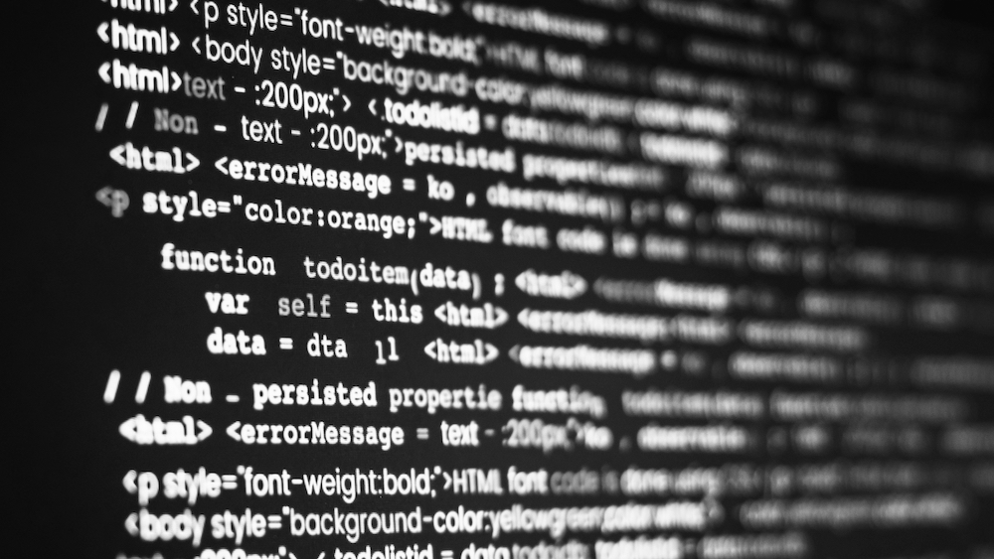
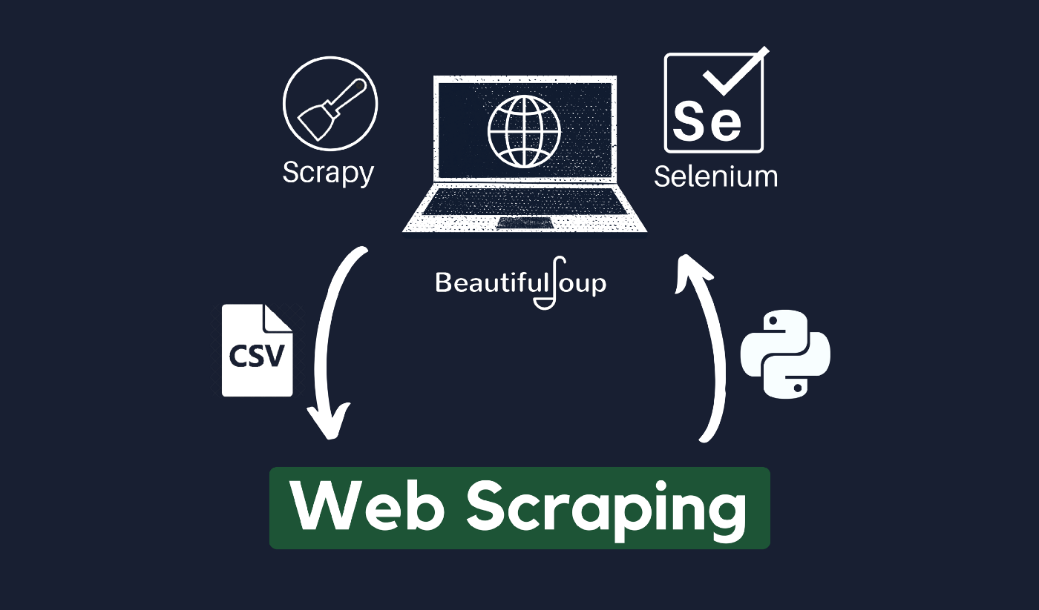
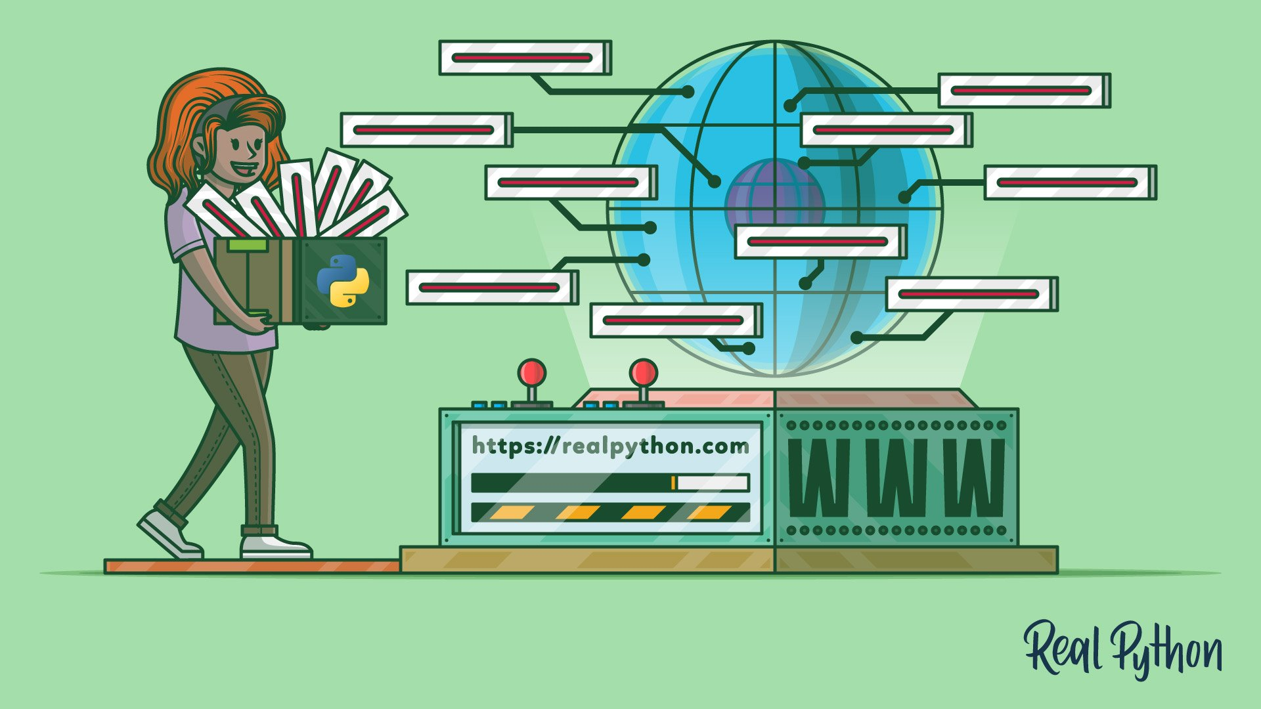
￼
Web scraping, web harvesting, or web data extraction as the name suggests is extracting data from websites. Unlike screen scraping, which only copies pixels displayed, web scraping extracts underlying HTML code and data stored in a database as well. The extracted data can then be stored as our need and can also be used to store information to our own new website.
Parse website data using string methods and regular expressions.
Parse website data using an HTML parser.
Interact with forms and other website components.

Slide 6
Intro to Django
Django is a high-level Python web framework that enables rapid development of secure and maintainable websites.
You can build almost any type of website using Django and also it takes care of much of the hassle of web development, So you can focus on writing your app without needing to reinvent the wheel. It is free and open source, has a thriving and active community, great documentation, and many options for free and paid-for support.
Top companies using Django: YouTube, Instagram, Spotify, etc
We’ll create a website using this framework and add various features into it.

Slide 7
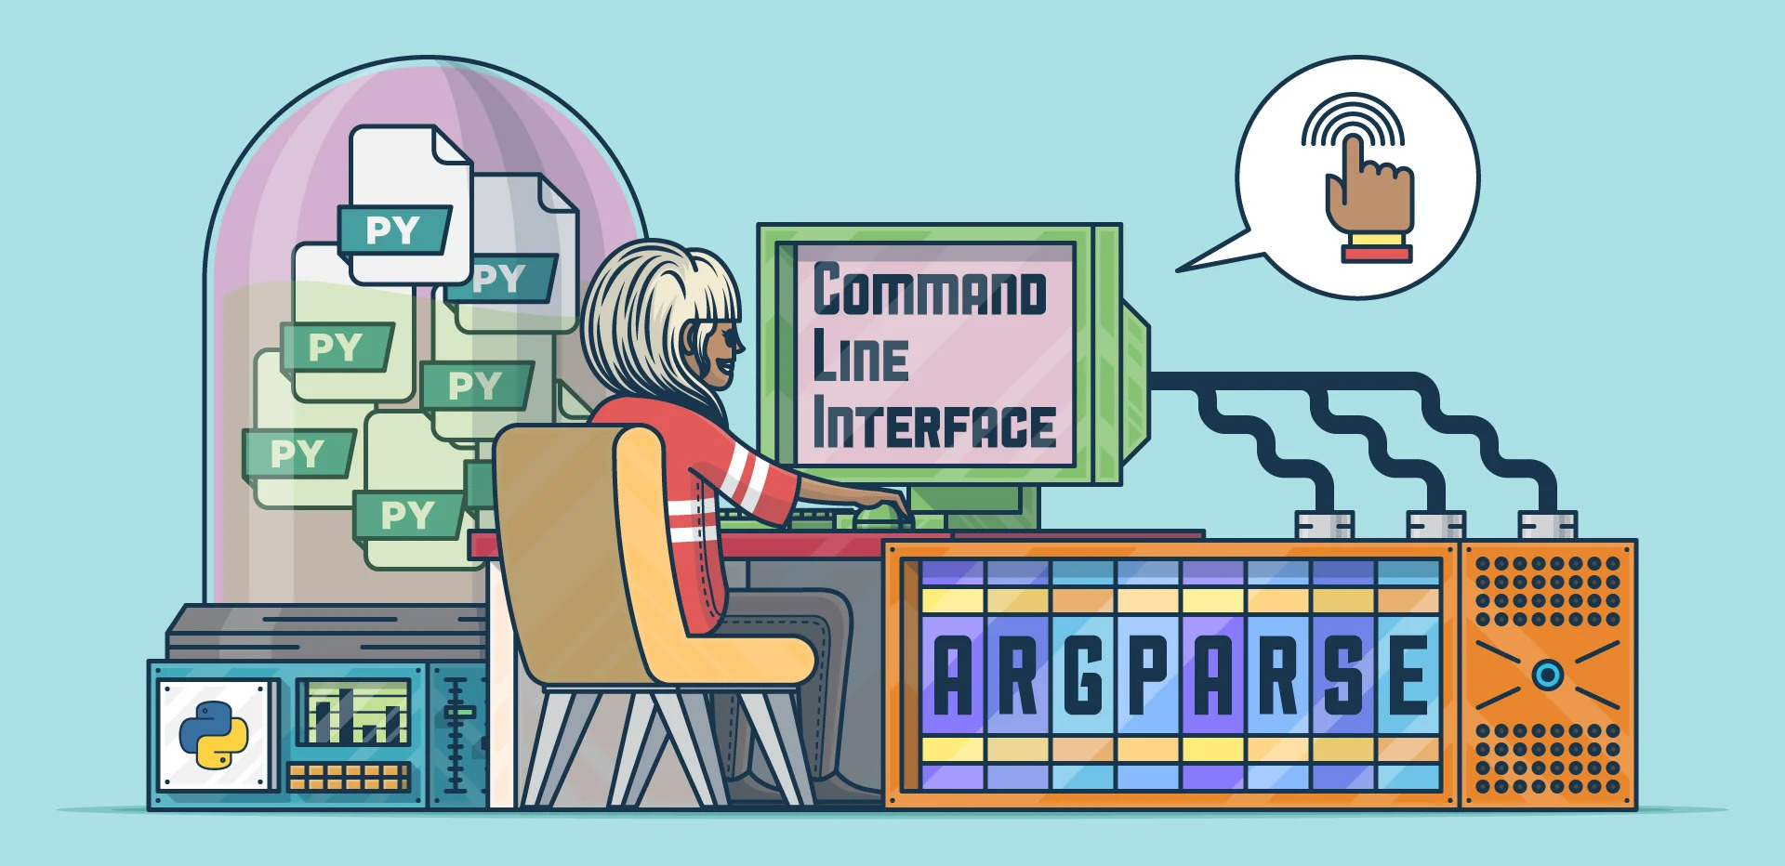
Python Scripts to implement Command line interface
The command line interface (also known as CLI) is a means to interact with a command line script. Python comes with several different libraries that allow you to write a command line interface for your scripts, but the standard way for creating a CLI in Python is currently the Python argparse library.
You’ll learn -
What is CLI
Python Argparse library and why it’s important to use it for scripts
Advanced use of Python Argparse library

Slide 8
Pre-requisites :
Familiarity to any programming language C, C++, Python etc.
Working hours / Commitment :
8 hr per week
Complexity :
Moderate

Slide 9

If there is any doubt , you can contact us without any hesitation :
Mentors :
Sandeep Kumar Birjania (sandeep20@iitk.ac.in)
Gautam Bansal (gbansal20@iitk.ac.in)
Ujjawal Goyal (ujjawalg20@iitk.ac.in)

